Slide 2
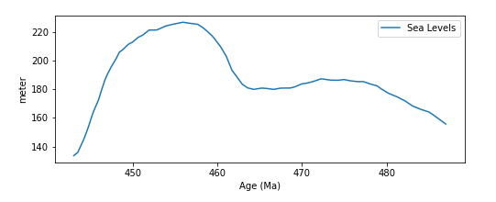
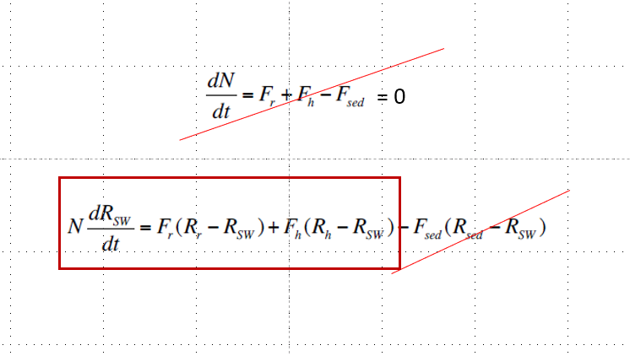
Constraining Fr and Rr
???

Slide 3
Riverine Ratio ??
Sr Isotopic Ratios of Archean and Grenvillian Rocks

Slide 4
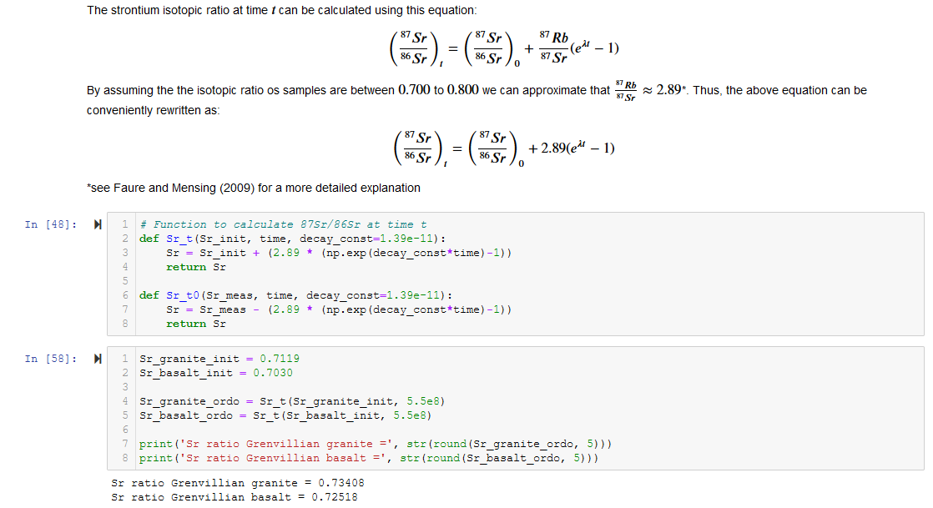
Approach #1

Slide 5
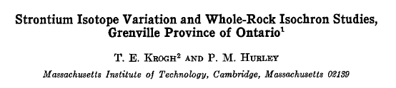
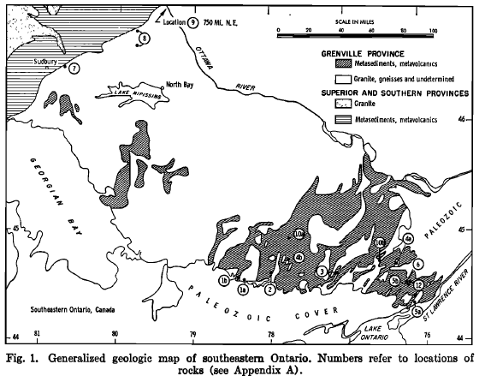
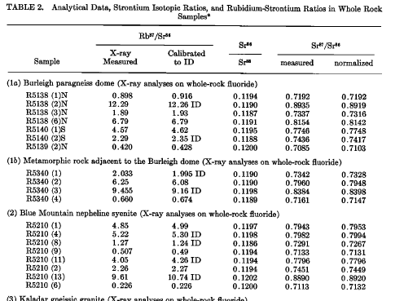
Approach #2
(Krogh and Hurley, 1968)

Slide 6
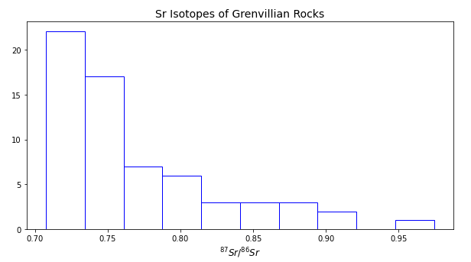
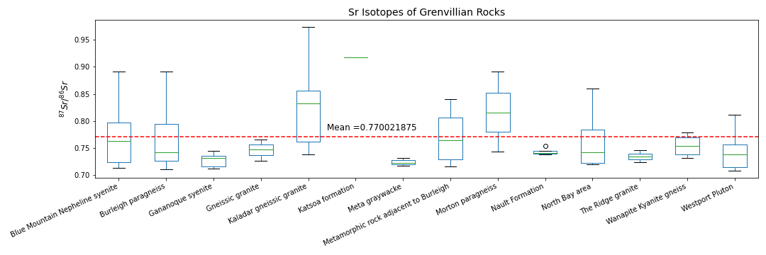
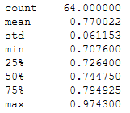
Approach #2
(Krogh and Hurley, 1968)

Slide 7
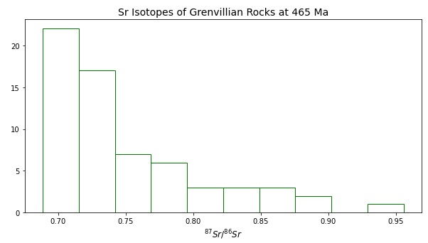
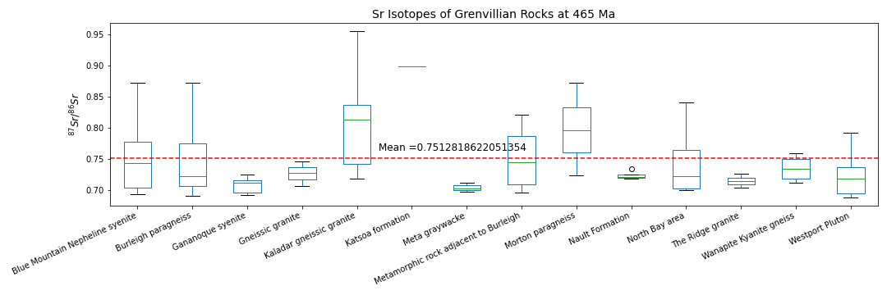
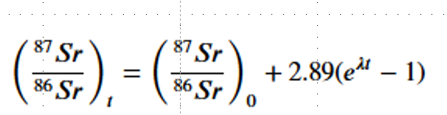
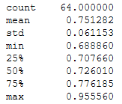
Approach #2 cont’d
(Krogh and Hurley, 1968)

Slide 8
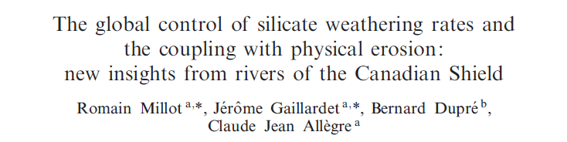
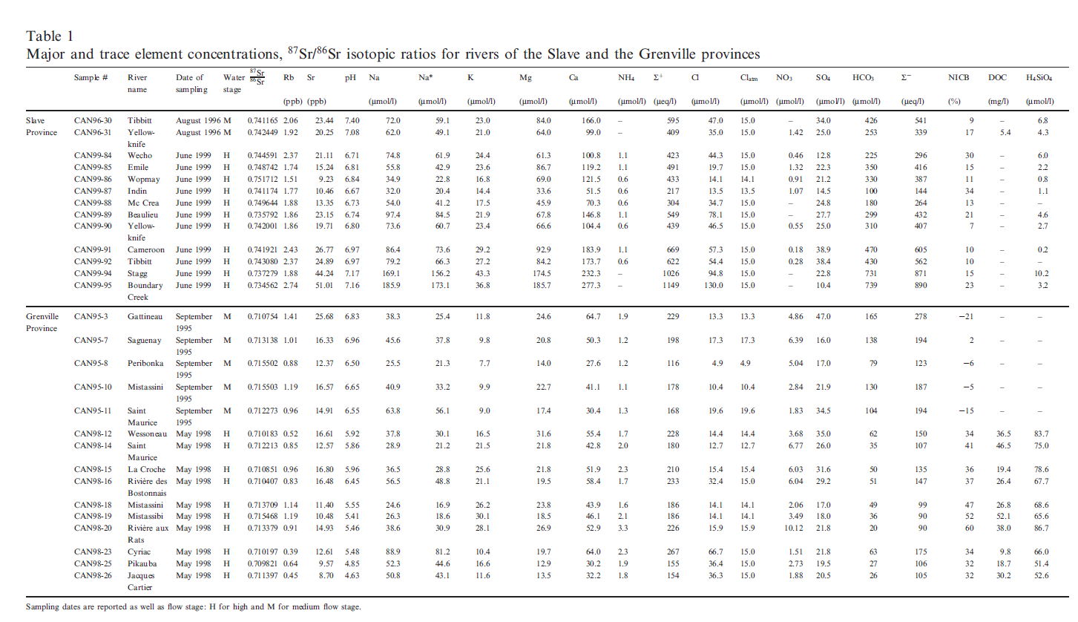
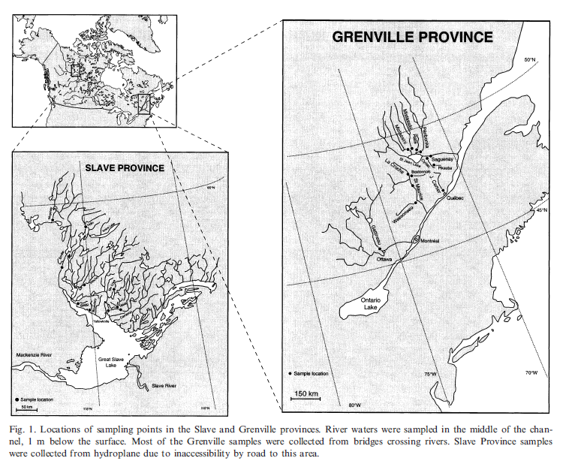
Approach #3
River Chemistry
(Millot et al., EPSL,2002)

Slide 9
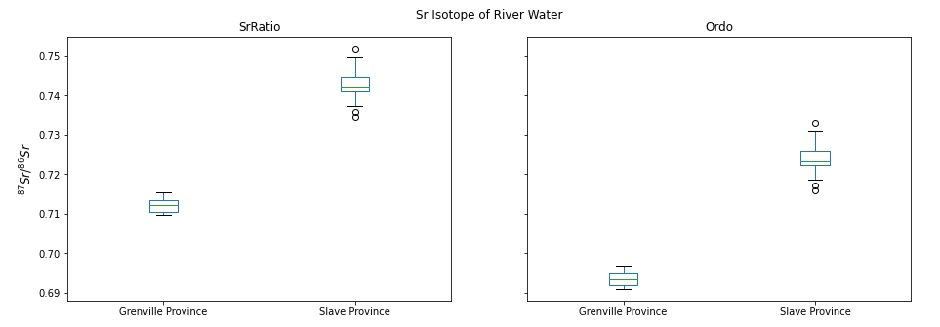
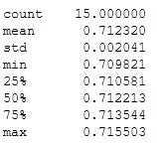
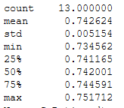
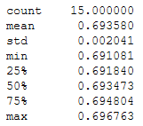
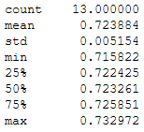
Approach #3

Slide 10
Summary
3 approaches to constrain Riverine ratios
granite – basalt mixing
metamorphic rocks
more radiogenic → Sr incorporation during metamorphism
river water
less radiogenic than expected
Riverine flux?
Laurentian source
Conwell et al model
..

Slide 11
Riverine flux ??

